Slide 1
Coursera Capstone
IBM Applied Data Science
James Kelleher
8/15/2019

Slide 2
Business Case
New Realtor in a new city seeks insights regarding neighborhoods that are similar
Provide a competitive advantage by focusing on areas that clients like the most
Focus efforts on productive areas that align with client needs and wants.

Slide 3
Data Sources
List of neighborhoods – wikipedia
  https://en.wikipedia.org/wiki/Neighborhoods_of_Portland,_Oregon
Foursquare
  Venues, Restaurants, trending hot-spots & insights
Portland Monthly
  https://www.pdxmonthly.com/articles/2017/3/22/portland-neighborhoods-by-the-numbers-2017-the-city
  Real estate data, demographics, commute info
Geopy/Geocoder
  Geographic coordinates for addresses & neighborhood coordinates

Slide 4
Data Strategy
Use a broad set of data categories that describe and differentiate neighborhoods.
Work with features that pertain to lifestyle and culture as well as typical real estate and demographic data
Identify similarities between neighborhoods throughout the metropolitan Portland area by categorizing neighborhoods into clusters.

Slide 5
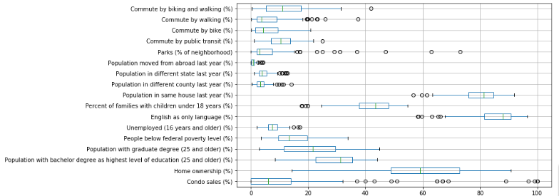
Methodology
Business Understanding
Data Mining
Data Cleaning
Data Exploration
Feature Engineering
Predictive Modeling
Data Visualization

Slide 6
K-Means Clustering
Unsupervised classification algorithm
Looks for hidden associations in the dataset
Iterative process, adjust parameters such as Foursquare radius, number of clusters, add / remove features etc. until clusters make sense and align with real world observations / validation

Slide 7
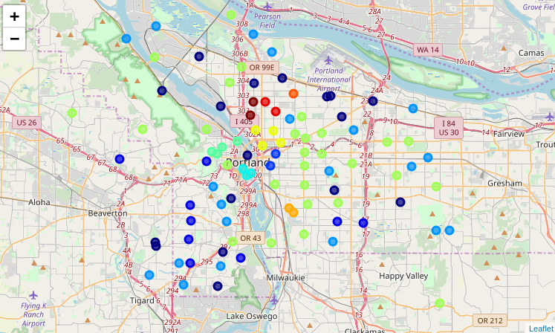
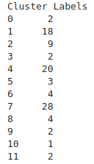
12 Clusters for 95 Neighborhoods

Slide 8
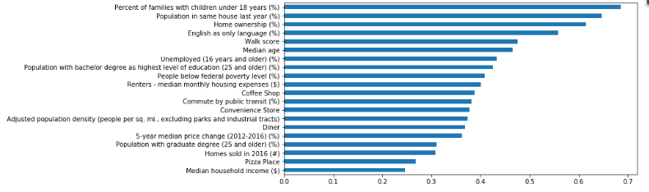
372 Features Evaluated
Top 20 Features summarized for each cluster

Slide 9
Discussion
Output consistent with google searches of neighborhood descriptions
Foursquare data likely biases the output due to over representation of venues. Can be addressed with python code to read Foursquare taxonomy and aggregate data to be more general, but out of scope for this iteration
Crime data was not available but should be included
Ideal Number of clusters is subjective & based on user feedback
‘Neighborhood’ may be too general, should explore possibility of grid based approach
Visualizations help, early versions of viz’s were useful in reducing the data set
Foursquare data is sparse in many areas. Recommend aggregating & then using PCA to reduce the feature set
Output is a useful companion to traditional realtor tools, not a replacement

Slide 10
Conclusion
The use of a clustering algorithm to classify neighborhoods for assisting realtors is certainly not new, but there is a gap in the area of clustering based on more abstract cultural and life style data that can be extracted from social media platforms and combined with more traditional real estate and demographic categories. This approach can help realtors to be more successful in their endeavors and help their clients find areas they would enjoy living in, helping them to look beyond their initial biases.

